Slide 1
Linear Algebra Review
Objects under consideration (real-vectors):
We will consider only the (representation of ) objects that are actually array of real numbers, some times called “real vectors”.
There are billions and billions of objects that are not “real-vectors”, however, we will focus today only on “real-vectors”.

Slide 2
Linear Algebra Review
Objects under consideration (real-vectors):
A point is also an array of real numbers
So, by our definition, a point is a vector
What is a position vector?
For every point there is a position vector
For every position vector there is a point
Can you draw a vector that is not a position vector?

Slide 3
Linear Algebra Review
Objects under consideration (real-vectors):
From now on wards, any array of real numbers can be named as a point or vector
Space?

Slide 4
Linear Algebra Review
Objects under consideration (real-vectors):
From now on wards, any array of real numbers can be named as a point or vector
Space?
Space is a set!
What is a set?

Slide 5
Linear Algebra Review
Objects under consideration (real-vectors):
From now on wards, any array of real numbers can be named as a point or vector
Space?
Space is a set!
What is a set?
Every set is not a space!
That means, space is a special set!

Slide 6
Linear Algebra Review
Objects under consideration (real-vectors):
Let me leave the discussion of Space for a moment!
Linear Combination?
Linear independence?
Independent vectors?
No vector can be constructed by others!
They are all independent to each other!

Slide 7
Linear Algebra Review
Objects under consideration (real-vectors):
The set of all possible linear combinations of independent vectors is called Space
The number of independent vectors is called Dimension of the space
What is the concept of ingredients?
Independent vectors act as ingredients to make new vectors

Slide 8
Linear Algebra Review
Objects under consideration (real-vectors):
We say that the independent vectors Span the space
Every object in the space is called a point
Dimensions vs. number of coordinates
The set of independent vectors that spans a space is called basis for that space

Slide 9
Linear Algebra Review
Objects under consideration (real-vectors):
So space is a set of objects
All these objects can be formed by a set of ingredients (basis)
Today we will not talk about “function-spaces” where the object under consideration will be “function”
There are many spaces, we are focusing on “real-vector-spaces”

Slide 10
Linear Algebra Review
Objects under consideration (real-vectors):
If you see a point with k-coordinates, what will be the dimension of the space that it will belong to?
Remember each coordinate is the amount of the corresponding ingredient!
Subspace
The importance of the null-vector!

Slide 11
Linear Algebra Review
Objects under consideration (real-vectors):
Line is a set!
Plane is a set!
The above sets are spaces only if they contain null-vector!
Colum Space of a matrix?
The space spanned by the columns of a matrix (independent columns?)
What do you think about Row Space of a matrix?

Slide 12
Linear Algebra Review
Objects under consideration (real-vectors):
b belongs to what?

Slide 13
Linear Algebra Review
Objects under consideration (real-vectors):
b belongs to what?
b belongs to the column space of A,
When does the above system become consistent, regardless of the choice of b?

Slide 14
Linear Algebra Review
Objects under consideration (real-vectors):
Convince your self that the above system is always consistent, regardless of the choice of A,
The set of all “x” that satisfy the above constraint, is a space, why?

Slide 15
Linear Algebra Review
Objects under consideration (real-vectors):
Convince your self that the above system is always consistent, regardless of the choice of A,
The set of all “x” that satisfy the above constraint, is a space, why?
That space is called Null Space.

Slide 16
Linear Algebra Review
Objects under consideration (real-vectors):
Linear independence of the columns
Invertibility of a matrix
Uniqueness of the solution of Ax = b
Dimension of the column space
Rank of a matrix
We are talking about the same concept with different names, the concept is “Linear independence”

Slide 17
Linear Algebra Review
Objects under consideration (real-vectors):
Rank(AB) = min(Rank(A),Rank(B))
Det(AB) = Det(A)Det(B)
Invertibility of AB?

Slide 18
Linear Algebra Review
Objects under consideration (real-vectors):
Transforms, Functions, Mappings, Converters, they are all “synonyms”
Let us Focus on the word “Transform”!
There are a billions and billions of transforms
Some of them are linear
Some of them are invertible
Some are linear as well as invertible

Slide 19
Linear Algebra Review
Objects under consideration (real-vectors):
What is a linear Function/Transform?
Remember Linear Combination?
Try to relate it with Linear Transform!
Transformation is linear, iff there always exists a matrix that when multiplied with input point, generates the output point.

Slide 20
Linear Algebra Review
Objects under consideration (real-vectors):
For Linear Transforms!
This is a big result!
Cascading linear transforms means matrix multiplications!
Check the inverse of the matrix and find whether the linear transform is invertible or not

Slide 21
Linear Algebra Review
Objects under consideration (real-vectors):
Examples of linear Transforms in 2-D,
Scaling,
Is the above transformation always invertible?

Slide 22
Linear Algebra Review
Objects under consideration (real-vectors):
Examples of linear Transforms in 2-D,
Shear in X,
Is the above transformation always invertible?

Slide 23
Linear Algebra Review
Objects under consideration (real-vectors):
Examples of linear Transforms in 2-D,
Rotation,
Is the above transformation always invertible?

Slide 24
Linear Algebra Review
Objects under consideration (real-vectors):
Translation?

Slide 25
Linear Algebra Review
Objects under consideration (real-vectors):
Translation?
Homogeneous coordinates
Translation is linear in homogeneous space!

Slide 26
Linear Algebra Review
Objects under consideration (real-vectors):
Orthogonality of vectors?
Dot Product!
Parallelism of vectors?
Cross product!
Cross product and the plane normal!

Slide 27
Linear Algebra Review
Objects under consideration (real-vectors):
Orthogonal spaces?
Null space is orthogonal to row-space?

Slide 28
Linear Algebra Review
Objects under consideration (real-vectors):
Orthogonality is strong linear independence
Orthogonal basis!
Orthogonal basis are desirable to simplify most of the computations
Gram-schmidt (QR decomposition)

Slide 29
Linear Algebra Review
Objects under consideration (real-vectors):
Orthonormal Matrix (Orthogonal)
All columns are orthonormal
All rows are orthonormal
It is a length preserving transform

Slide 30
Linear Algebra Review
Objects under consideration (real-vectors):
Examples of Orthonormal Transforms
Rotation (2-D, 3-D)
Reflection
Permutation
Closure under Multiplication
What is a group?

Slide 31
Linear Algebra Review
Objects under consideration (real-vectors):
Let “A” be a linear transform (assume square matrix).
Give me a vector “x” such that the transform A does not change its direction!
Ax has the same direction as x,
Ax and x are both parallel

Slide 32
Linear Algebra Review
Objects under consideration (real-vectors):
Eigen values are preserved under Transpose,
Eigen Vectors are preserved under exponentiation,

Slide 33
Linear Algebra Review
Objects under consideration (real-vectors):
Eigen vectors corresponding to distinct Eigen values form a linearly independent set

Slide 34
Linear Algebra Review
Objects under consideration (real-vectors):
invertibility
Rank
Linear Independence
Dimension of the column space
Dimension of the null space
Eigen values
Unique solution

Slide 35
Linear Algebra Review
Objects under consideration (real-vectors):
Symmetric Matrix
Eigen Values? All real?
Eigen Vectors? Orthonormal?
How many orthonormal eigen vectors? n?
That means the matrix of n orthonormal eigen vectors of a symmetric Matrix is an orthonormal matrix!
So what?

Slide 36
Linear Algebra Review
Objects under consideration (real-vectors):
Semi-definite Matrix (Symmetric)
Positive Semi-definite
Negative Semi-definite
Choulsky Decomposition! Unique?

Slide 37
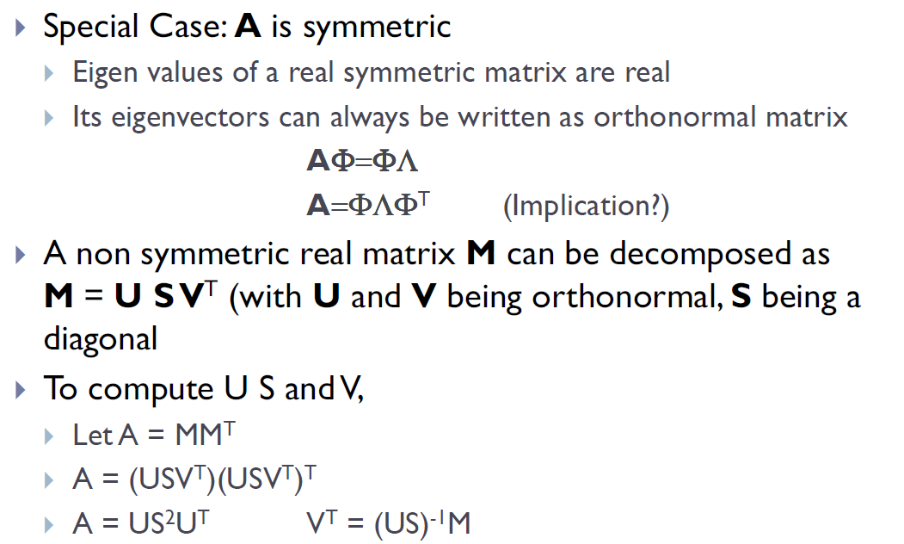
Full Rank Approximation: SVD

Slide 38

Multivariate Gaussian
MLE ?
Covariance Matrix? Degenerate?
Full rank approximation!

Slide 39
Questions!!

